Slide 1
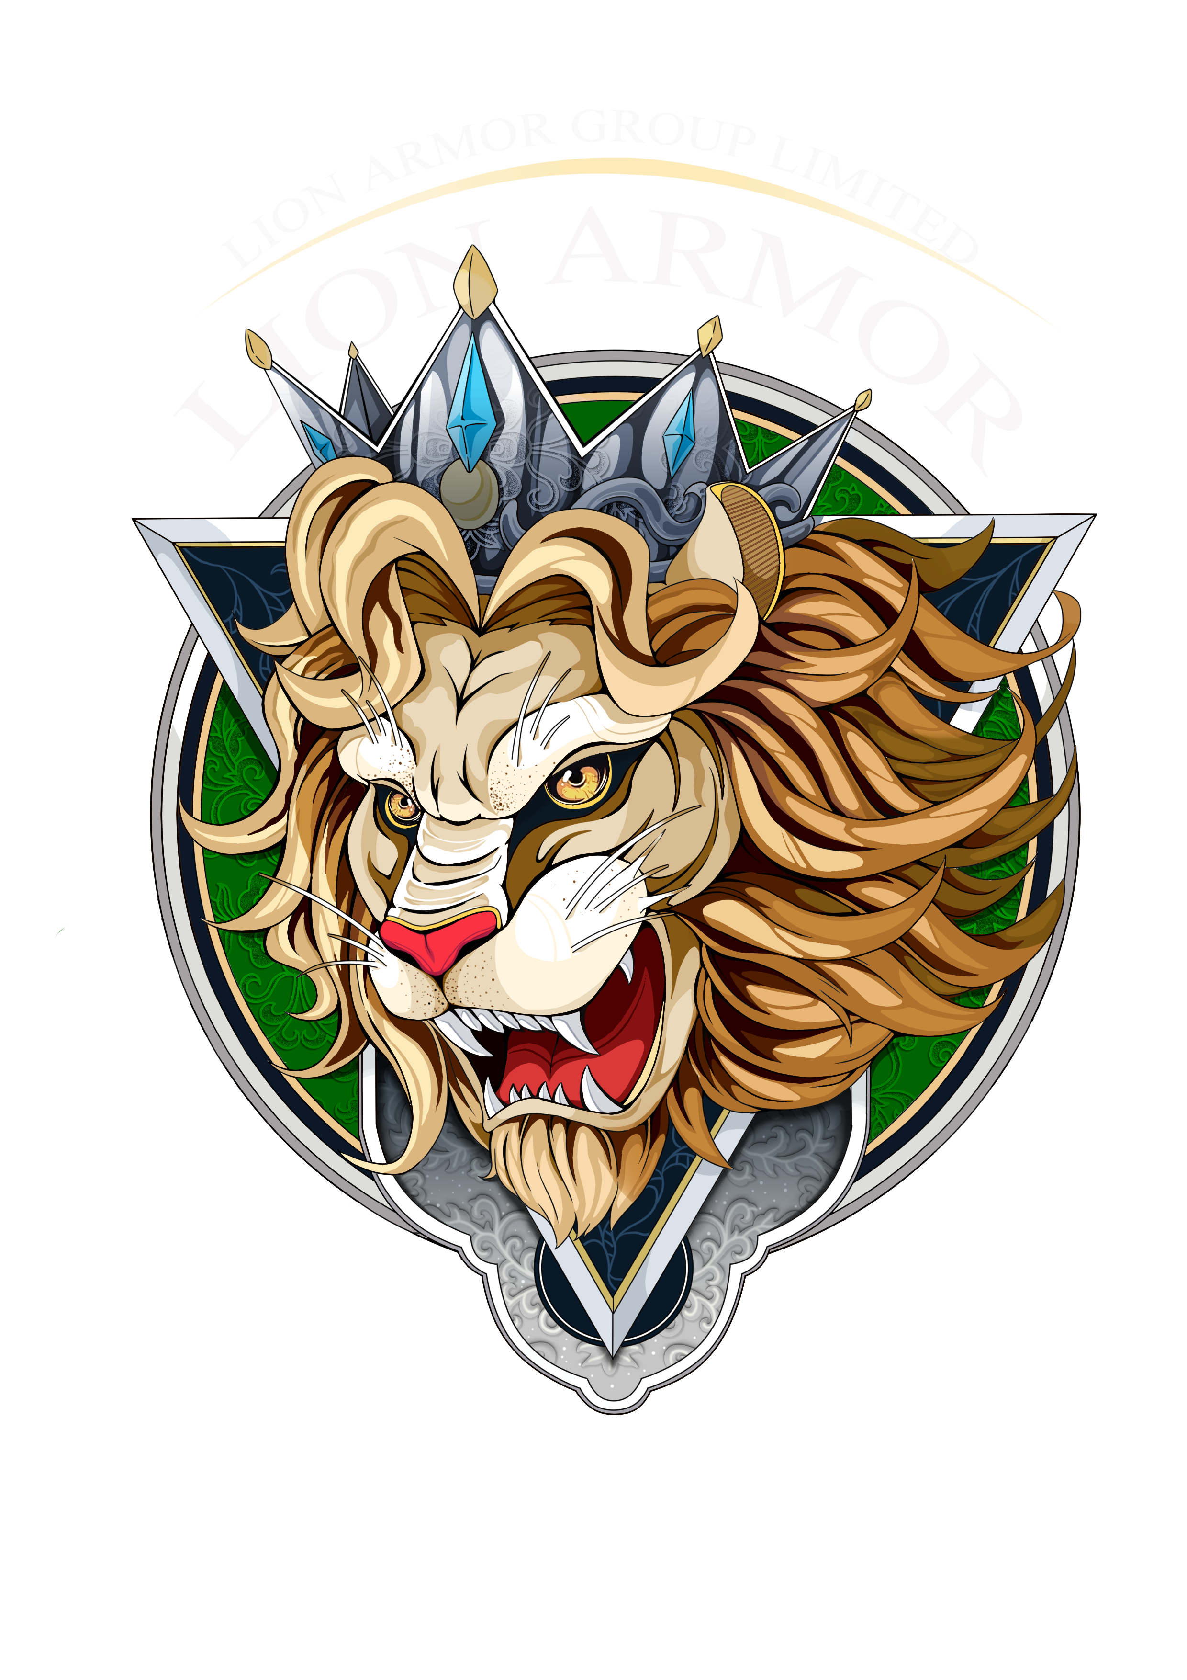
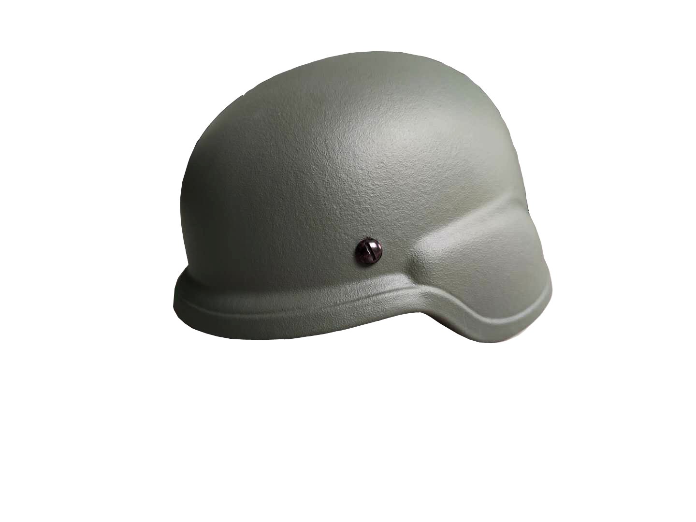
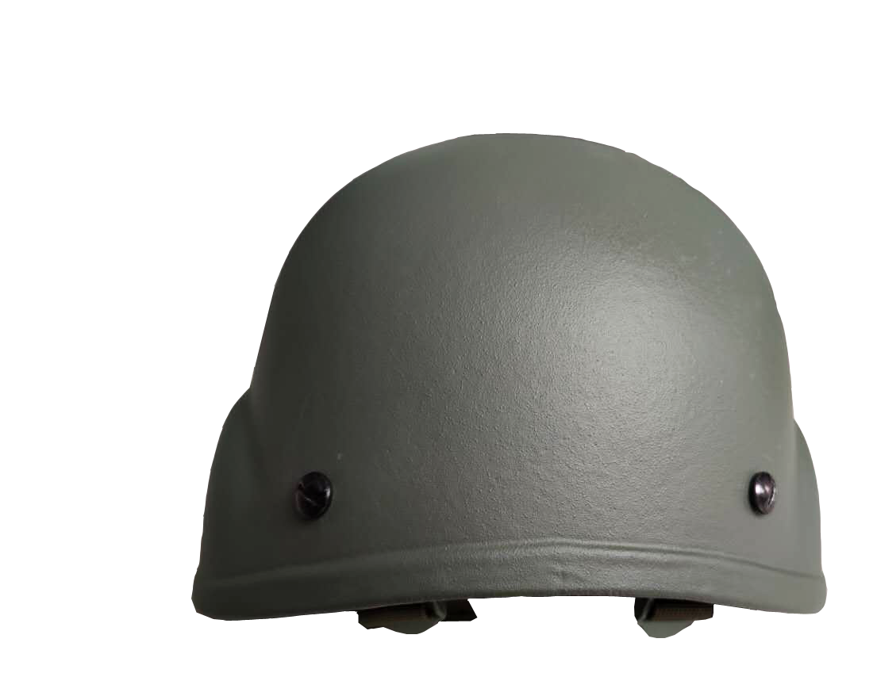
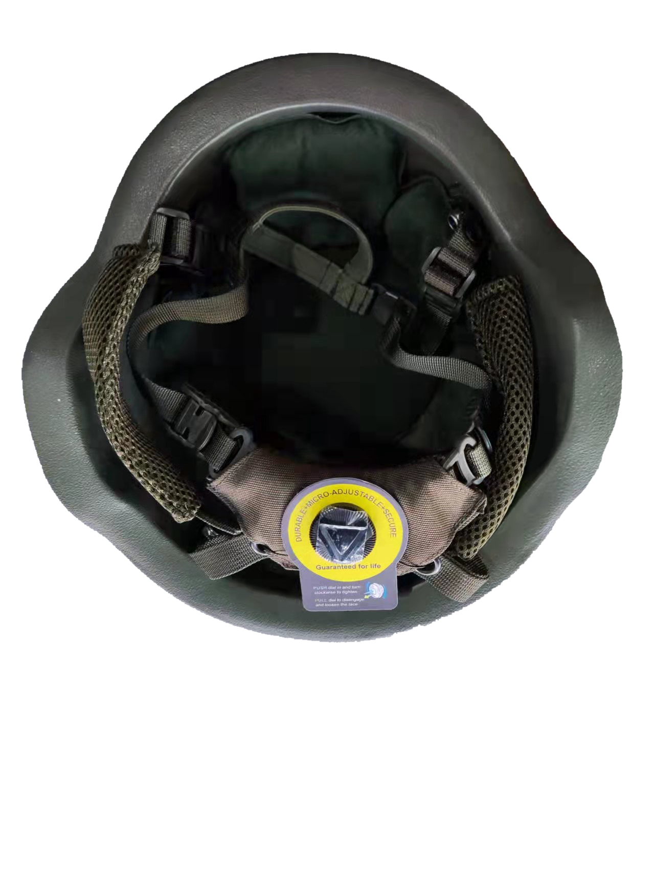
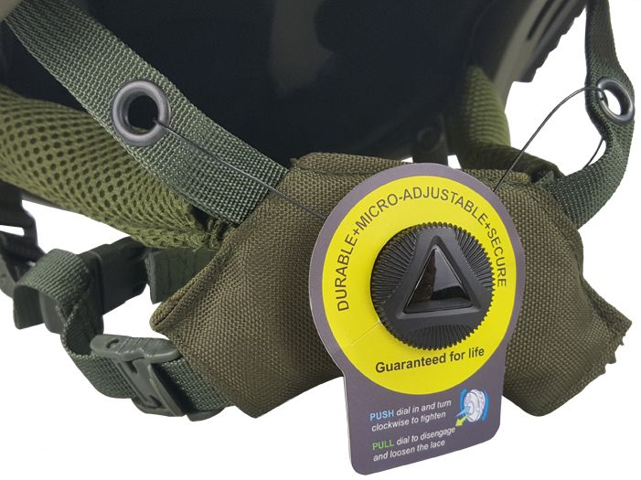
LION ARMOR
HELMET
AK PASGT
--Ballistic Helmet /PE Material
Model: PASGT
Material: PE
Level: Level III AK47 7.62mm lead core bullet
Size: M/L
Color: Black, OD Green, Ranger Green, Sandy
1

Slide 2
LION ARMOR
HELMET
Short Description
“The only AK 100M/50M/15M helmet manufacturer in China”
The helmet is made of UHMWPE material, which is light in weight, flexible and comfortable to wear, waterproof, resistant to ultraviolet rays, can be used in harsh environments, heat-resistant and not easily deformed.
To ensure maximum protection, our LA-P-AK ballistic helmets offer a large protective zone for reliable coverage around your head. Additionally, it can equipped with rails for carrying communications equipment and other tactical accessories, making it ideal for a variety of tactical operations.
We understand that safety is essential in any situation and believe our helmets are a valuable addition to any protective gear arsenal. Our helmets are heat-resistant and resistant to deformation, ensuring optimum performance even in extreme conditions.
2

Slide 3
LION ARMOR
HELMET
Specifications
Style | Serial No. | Material | Bulletproof Level | Size | Circumferen ce(cm) | Size(L*W*H) (±3mm) | Thickness (mm) | Weight (kg)
PASGT FOR AK | LA-HP-AKN | PE | AK (Lead core) 100 m | M | 54-58 | 284×254×185 | 18±0.2 | 2.45± 0.05
 |  |  |  | L | 58-62 | 292×265×190 | 18±0.2 | 2.50± 0.05
 |  |  | AK (Lead core) 50 m | M | 54-58 | 284×254×185 | 18±0.2 | 2.45± 0.05
 |  |  |  | L | 58-62 | 292×265×190 | 18±0.2 | 2.50± 0.05
 |  |  | AK (Lead core) 15 m | M | 54-58 | 284×254×185 | 18±0.2 | 2.45± 0.05
 |  |  |  | L | 58-62 | 292×265×190 | 18±0.2 | 2.50± 0.05
2

Slide 4
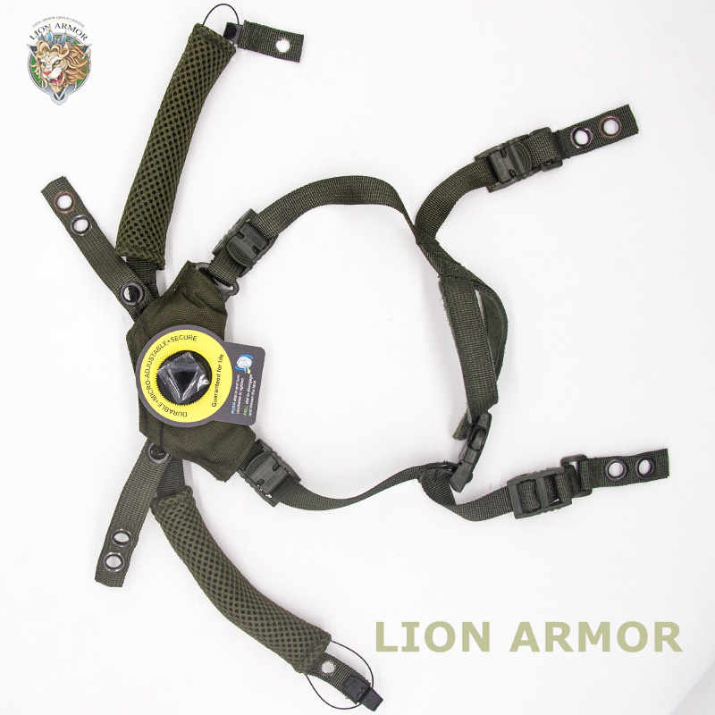
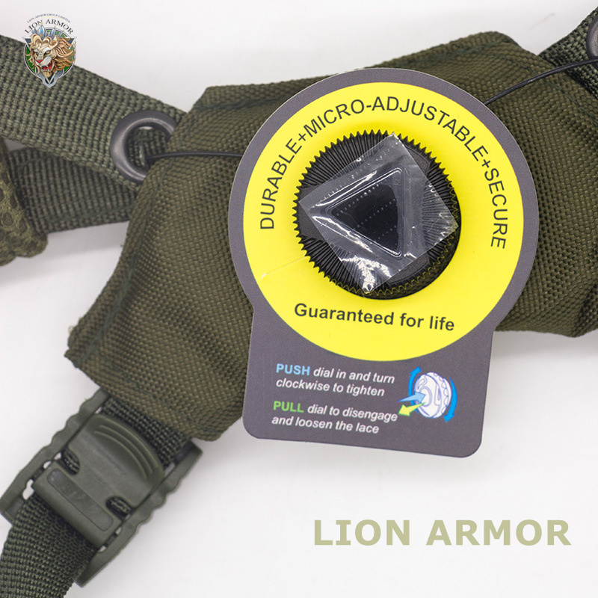
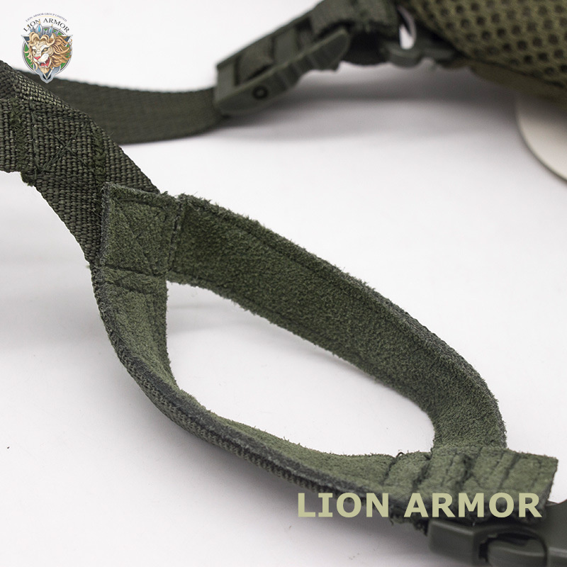
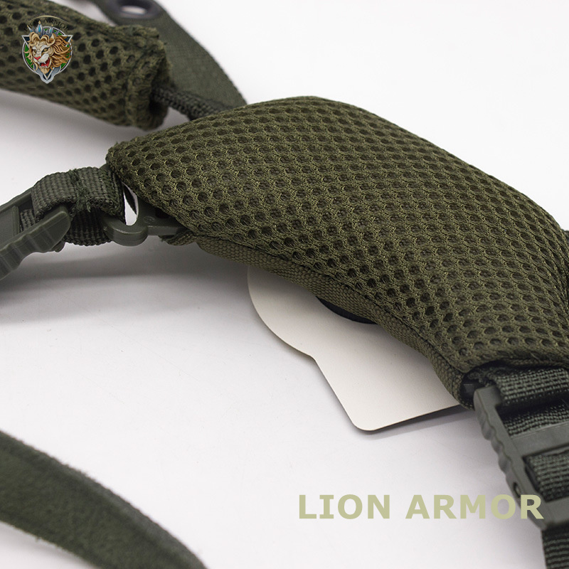
LION ARMOR
HELMET
Accessories
Liner: Standard 7 Pads /memeroy foam
General Suspension: High quality BOA fit adjustment systems.
Accessories are self-produced, can be purchased separately. If you have accessories demand details, please consult for more information.
-- All LION ARMOR products can be customized.
5

Slide 5
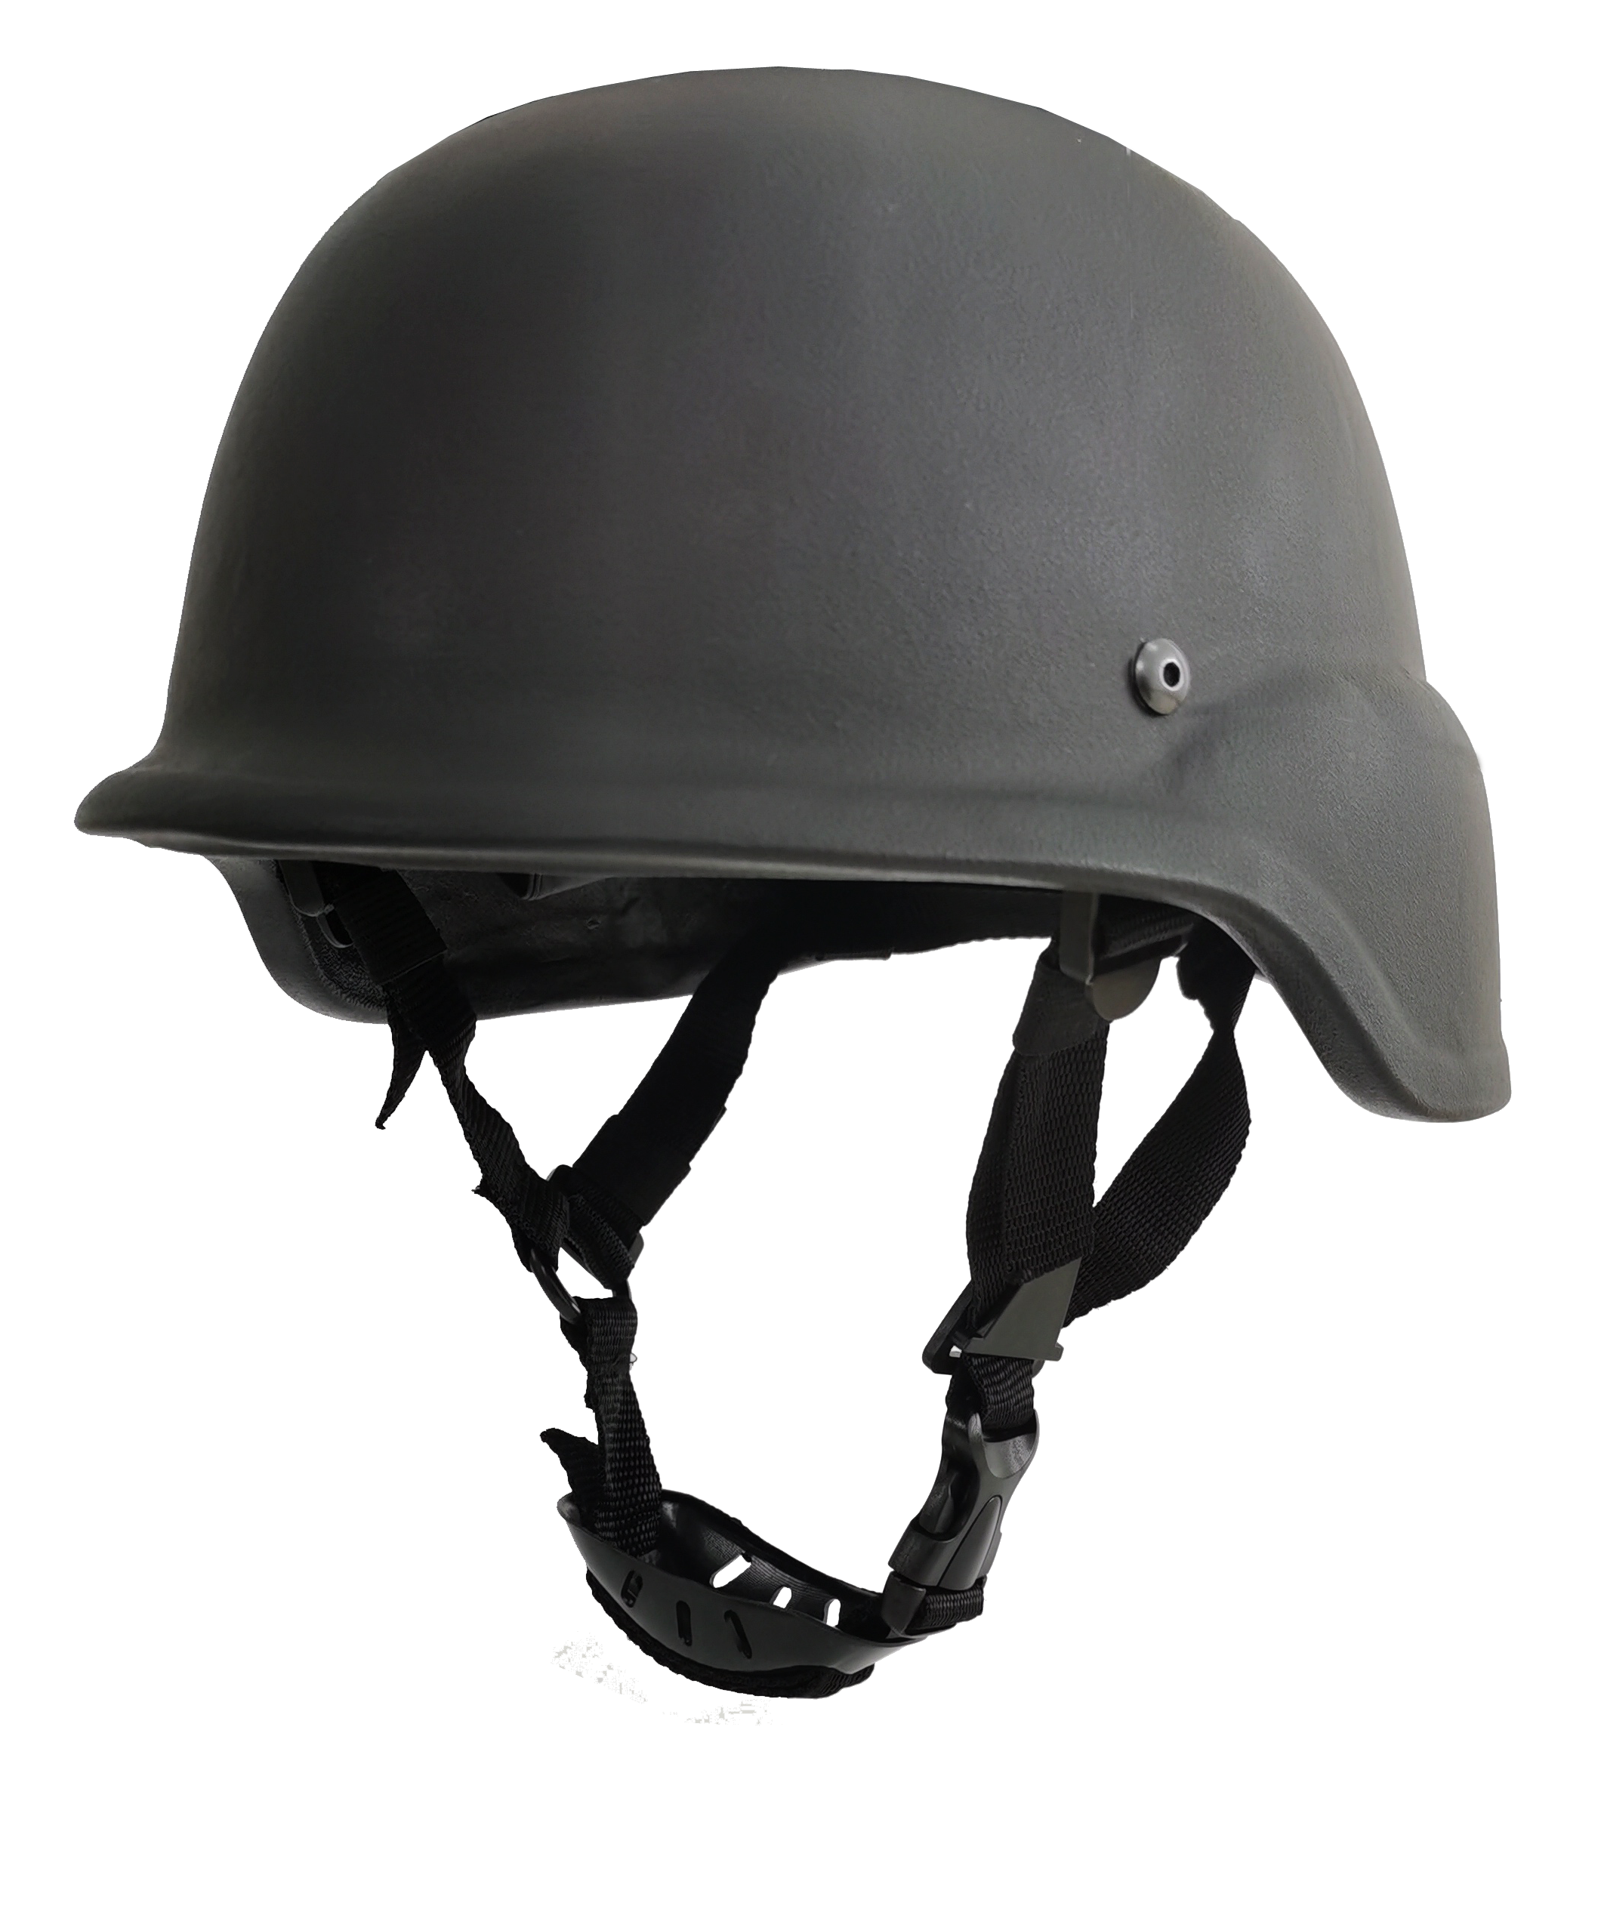
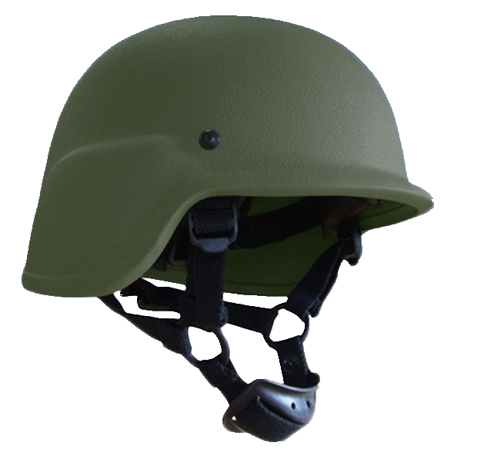
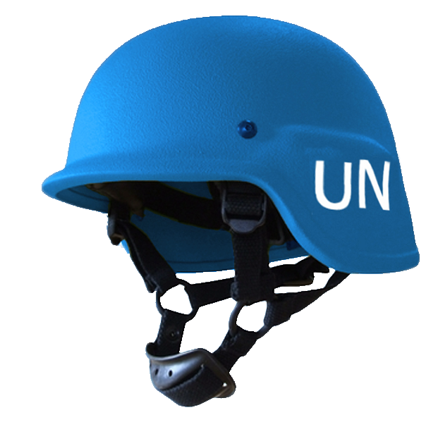
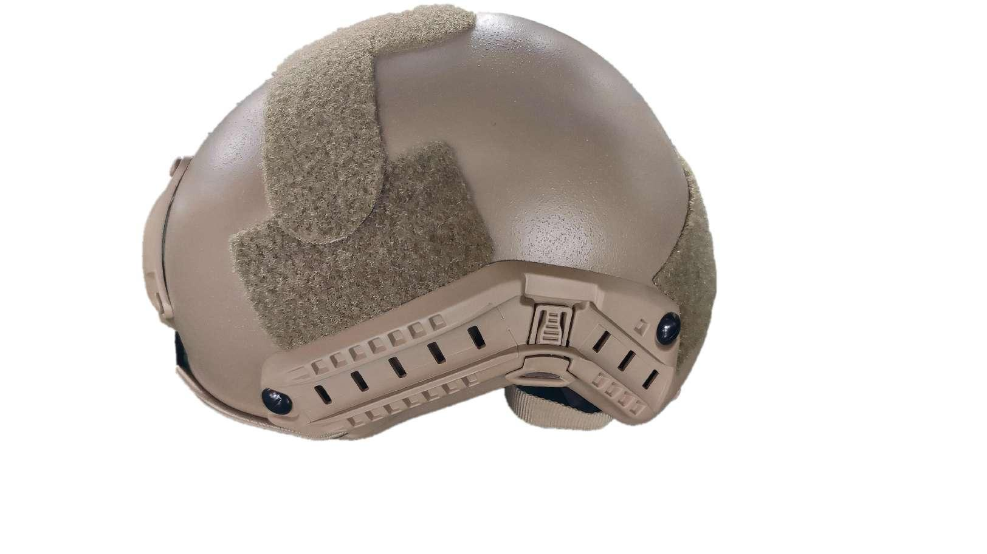
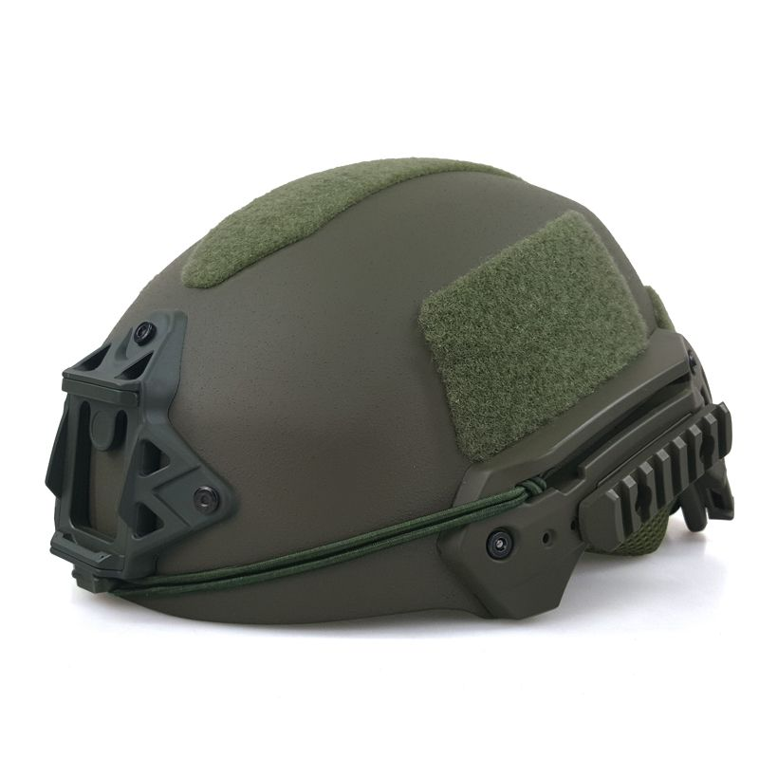
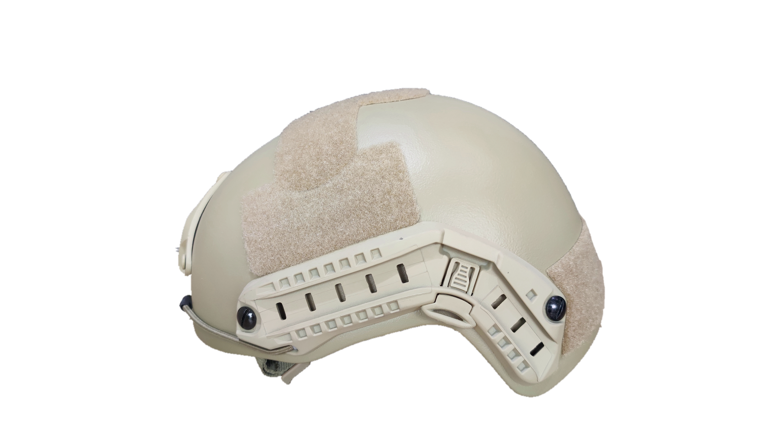
LION ARMOR
HELMET
Available Colours
Normal: Black, OD Green, Ranger Green, Coyote, Sandy, UN Blue,
Customized: Muddy, Khaki, Police Blue, Light Olive green, Camouflage. (Customized)
Black
OD Green
UN Blue
Ranger Green
Sandy
Coyote
3

Slide 6
LION ARMOR
HELMET
OEM/ODM
The helmets are customized for special defense purpose for African market.
Can be added rails / shroud / Velcro to be tactical helmet.
Customize:(Additional charge, please consult for details）
Outer cover can bee added （For details, please consult）
Test Certification
China Test Agency:
* BULLETPROOF MATERIAL TESTING CENTER OF ZHEJIANG RED FLAG MACHINERY CO., LTD
6

Slide 7
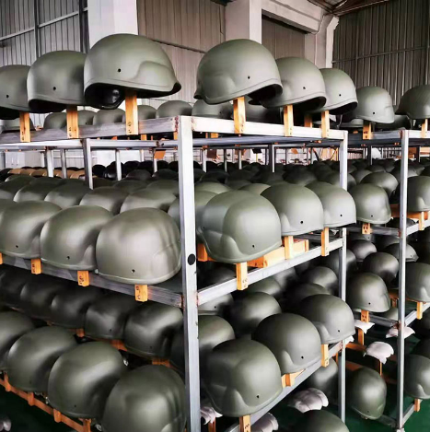
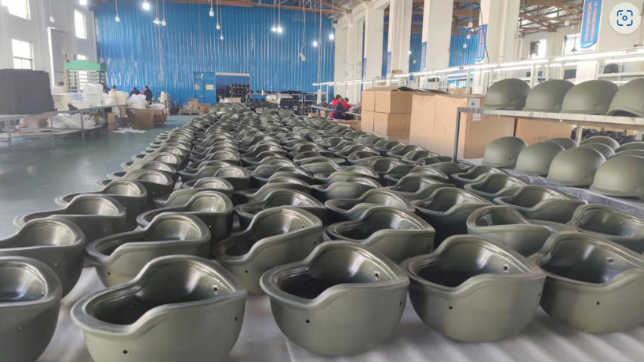
LION ARMOR
HELMET
Photos of production
Product storage: room temperature, dry place.
8
Serial | Packing Method | CTN Size （mm） | Gross weight ( kg)
1 | 1pcs/CTN | 300*270*200 | 1.8
2 | Each helmet packed alone, 5pcs/CTN | 660*540*330 | 11
3 | Helmet packed together, 5pcs/CTN | 660*280*305 | 10
4 | Helmet packed togther, 10pcs/CTN | 660*550*330 | 16
Serial | Packing Method | CTN Size （mm） | Gross weight ( kg)
1 | 1pcs/CTN | 300*270*200 | 1.8
2 | Each helmet packed alone, 5pcs/CTN | 660*540*330 | 11
3 | Helmet packed together, 5pcs/CTN | 660*280*305 | 10
4 | Helmet packed togther, 10pcs/CTN | 660*550*330 | 16
Serial | Packing Method | CTN Size （mm） | Gross weight ( kg)
1 | 1pcs/CTN | 300*270*200 | 1.8
2 | Each helmet packed alone, 5pcs/CTN | 660*540*330 | 11
3 | Helmet packed together, 5pcs/CTN | 660*280*305 | 10
4 | Helmet packed togther, 10pcs/CTN | 660*550*330 | 16

Slide 8
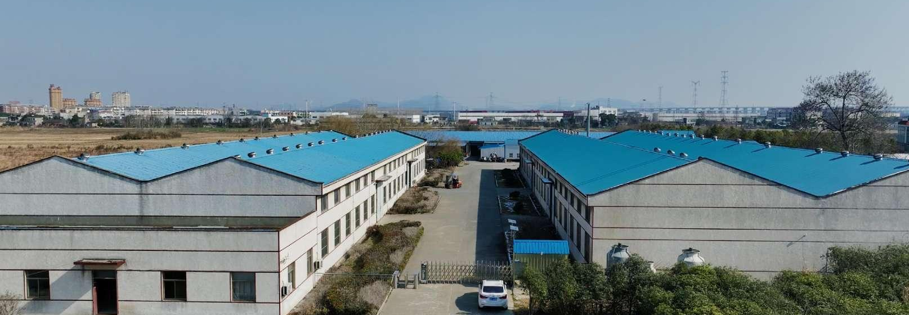
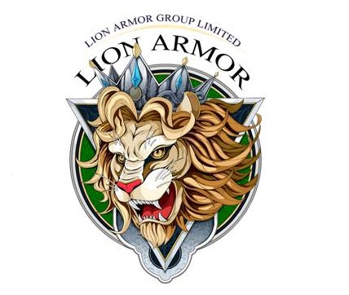
CONTACT INFO
LION ARMOR
HELMET
April
Sales Director
LION ARMOR GROUP LIMITED
Website : www.labodyarmor.com
Sales Office Address : Base No.17, Haishanghai Garden, No.168 Majiapu East Road, Fengtai District, 100068 Beijing，China.
Mob/Whatsapp: +86-18810308121
E-mail: april@lion-armor.com
9

